Slide 2
Notes:
The Grand Union Canal – then & now
Today we are going to learn about the Grand Union Canal – its history and how it is used today. This is the closest canal to your school. We’ll also learn about safety near the canal if we visit there.
Q: Does anybody recognise this place?
A: Soulbury or The 3 Locks, near Great Brickhill
When we want to find out about something, there are some very useful words that can help us ask questions.
Q: Who can tell me any of these words?
A: What? When? How? Where? Why? Who?
(Children should know these. If not prompt them by giving them one of the words. They will then think of the others.)

Slide 3
Notes:
Keywords
I am going to be using some words you may not know, so here are some of them.
This sheet can be printed off and used for creative writing or other activities.

Slide 4
Notes:
What is a canal? – sorting activity
A selection of images handed out on the tables for sorting + post it notes – “river” & “canal”. Discuss in groups
Now talk together about the difference between a canal and a river, looking at the pictures to help you. Then you can sort them into 2 groups
Q: Is it a river? Or a canal?
Listen in to responses in discussion. They will come up with all sorts of answers including ‘Canals are smaller than rivers’. ‘Canals are dirtier than rivers.’ ‘Canals have boats on them.’
For most of their answers the response is: “Well that’s sometimes true but I’m looking for something which is always true.”
A: Canals were made by people. They have steep, straight sides.
Rivers are natural, they often bend and have uneven edges.

Slide 5
Notes:
Canal or river?
Q: Is this a picture of a canal or a river?
A: River
This is the River Ouzel in Milton Keynes.
You can see the banks of the river are curving and the edges are uneven – the water has sometimes flooded over and helped plants to grow well by the water.

Slide 6
Notes:
Q: Is this a picture of a canal or a river?
A: It’s a canal.
This is the Grand Union canal near Leighton Buzzard, not far from here.
You can see the banks of the canal are straight and have been built by people.
The edges are steep and go straight down into the water.
The canal water does not go up and down, it’s the same in summer and winter.
The boats are often narrower than on a river – they are called barges, or narrowboats.

Slide 7
Notes:
When was the canal built?
Q: Who would like to have a guess how many years ago the Grand Union canal was built?
CLUE: It’s from a time before cars and trains had been invented at all …
Take answers from the children. You can say higher or lower depending on their answers.
A: When (if) somebody says 200 years old , say “You’re very close.”
Let’s find out together when it was built……
Timeline activity
I’d like 4 children from the class to come up to the front to hold something up … (choose 4)
Give each child a large card from Lesson resources pack, with the timeline dates on: 2019, 1939, 1837, 1797 and a ribbon to join them
Other children sort them into reverse order, going backwards in time with ribbon held by each child as a timeline. Let’s check that….

Slide 8
Notes:
Timeline activity
Pass the children in timeline a ribbon between them, one by one to show time going backwards from today.
Q: Can anyone fill in my blank spaces with events in the past?
A: Second World War / World War 2 and Victoria
So now we know that the Grand Union Canal was started in 1797, before there were any cars, lorries or trains.

Slide 9
Notes:
When was it built?
The Grand Union Canal was started in 1797 and it was opened in stages as it was finished.
It was all completely open in 1805.
Q: Who can work out how many years it took them to finish it? (Point to the two dates on the slide)
A: 8 years
This is a picture of the opening ceremony of the canal in Paddington in 1801.
You can see lots of people waving their hats and boats with flags on the masts, as it was a big celebration. A bit like the opening ceremony of the Olympics.
For the time in history, it was a major engineering success and was very expensive and important.

Slide 10
Notes:
How did they build the canal?
Today we use big machines, cranes, diggers for building new structures.
Q: What do you think they had to use to dig the canal in those days?
Give a clue if needed: role-play digging using a spade, swinging pickaxe
A: Hand tools such as spades, pickaxes and wheelbarrows
Let’s have a look at some of the people who dug the canals …

Slide 11
Notes:
Navvies
Here is a picture of some men working on the canal in the late 1800s.
They were called ‘navvies’ from the early word for canals - ‘navigations’.
Q. What can you see in the picture?
A: Children describe spades, wheelbarrows, men talking, man supervising
Q. What do you think they were saying to each other? Just your ideas?
Children’s ideas
Their work days were long and it was a very dangerous job. Some were injured and some people died in accidents.
Mud and water could slide in on top of them at any time. Safety was not as strict as nowadays.

Slide 12
Notes:
Where does the canal go?
We need to look at a map to find where the canal goes…..

Slide 13
Notes:
Where does the canal go?
Here is a map of the Grand Union Canal.
It is 127 miles long from Brentford (near London) to Birmingham. It has lots of short canals branching off it called ‘arms’.
The canal closest to your school and homes is at Soulbury Three Locks, south of Milton Keynes (with a red arrow) and north of Leighton Buzzard.
You can visit there with your families and I’ll be sending information out through school about how to visit. There is now a Family Trail quiz that you can get online.
London
Birmingham
Milton Keynes

Slide 14
Notes:
Why did they build the canal?
Q: Why do you think they built a canal?
Take answers from children
A: To transport cargo – this means heavy things for people to trade and sell.
They had roads, but they were bumpy and often muddy. It was very slow to transport cargo by pack-horses as they had no railways or lorries yet.
One packhorse could carry about 100kg of goods – like 100 bags of sugar. One horse-drawn narrowboat could carry about 20 tons of cargo, which is about 200 horses in weight.
Hold up some examples of cargo: a building stone, pottery vase, coal
Q: What do you think these are?
A: Coal, building stone, pottery

Slide 15
Notes:
Cargo
Here is a picture of a boat being loaded up with cargo in London. There are two other boats moored next to it.
Provide to each table: a tray of gravel, some loose tea, small wooden plank, fine china. Children can explore and touch each cargo and try to identify it.
Q: What do you think they would have used each cargo for?
A: Children’s ideas: It’s XXXX, they used it for XXXXXXX
Gravel – building
Timber – building
Tea – very important trade as tea was very popular from 1800s
China and pottery – the earliest canals were built to gently carry china as the roads were so rough and bumpy
Coal – most important cargo on the canal, for heating & cooking

Slide 16
Notes:
Work on the canal
There were a number of jobs on the canals.
Some people worked and lived either on boats or next to the canal in small cottages.
We’ll look at a few of these:
Toll – keeper
Boat families
Horses

Slide 17
Notes:
Work on the canal: Gauging a boat
Boats coming up the Grand Union canal had to be weighed and pay a toll (money). A bit like paying the congestion charge when going into London.
How much they paid depended on how much cargo they were carrying and what they were carrying.
Here is a picture of a toll keeper in London, measuring or ‘gauging’ the boat. He used a measuring stick to measure how low the boat was in the water.

Slide 18
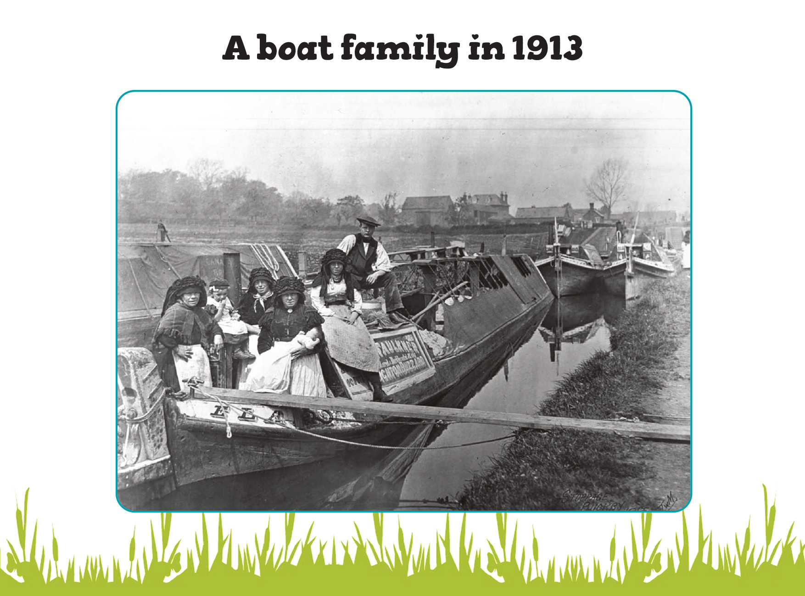
Notes:
Boat family in 1913
In the 1900s, whole families used to live in small cabins at the back of the boat. Women and children worked on the barges as well as men.
Here is a picture of a family.
Q: What do you see (describe)?
They are wearing their best clothes
A baby in special clothes- for its Christening, a special naming day
Women wore special hats called bonnets with ribbons to tie them
Men wore big wide caps.
Q: Why do you think the bonnet and the cap come right down over their eyes?
A: To protect them from wind, rain, dirt and sun. They worked and lived in all weather, including winter snow and ice.

Slide 19
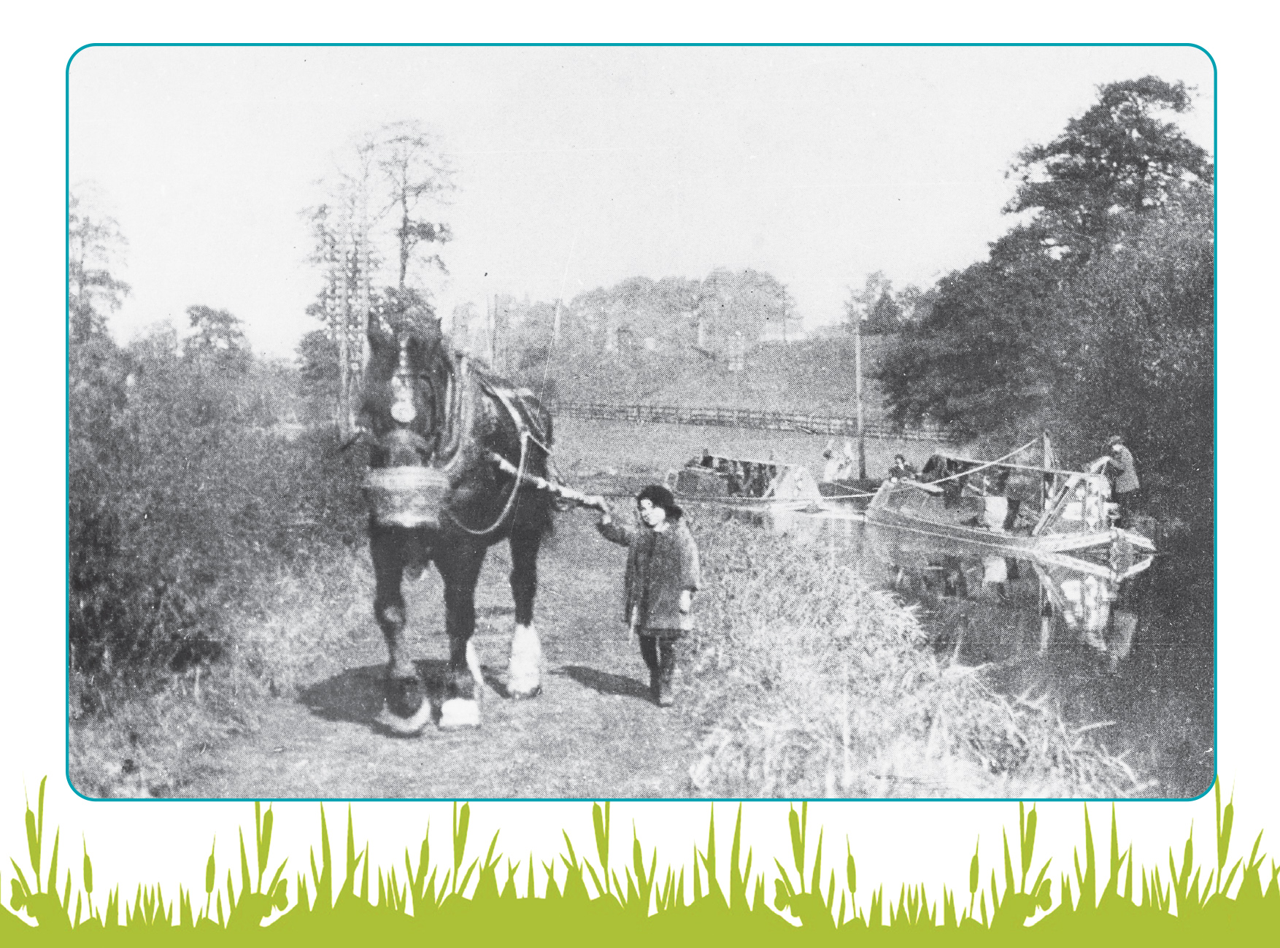
Notes:
Horses
Here is a picture of what you might have been doing if you were a member of a boat family.
Q: How is the boat being pulled along here?
A: The boats were pulled by horses as there were no engines in them.
Sometimes it was the children’s job to lead the horse along the towpath. This horse has a nosebag with some food as it worked hard all day.
Q: What would you say to the horse if you were leading it, you had to keep it moving along?
A: Ideas – “Gee up!” etc

Slide 20
Notes:
Soulbury 3 Locks today …
Q: Do you remember the picture I showed you at the beginning of the lesson – Soulbury 3 Locks Then and Now?
Show the picture again if needed as a reminder
We’re going to look at what there is to do if you visit the canal with an adult, then we’ll practice our safety code for canals and rivers.

Slide 21
Notes:
This is the closest canal to your school. The old view is in black and white, the modern one is in colour.
It’s called Soulbury 3 Locks, near Great Brickhill and people can visit here by parking under some trees in a car park, or at the pub on the left.
We’ve learnt some facts about the canal here: our What? When? How? Where? Why? Who? Questions.
Let’s look at what there is to see now…

Slide 22
Notes:
Visiting Soulbury 3 Locks now
Have a good look at this map of the place.
Q: What can you see?
A: gates, bridge, house, buildings, road, boat, animals
If you visit, there is lots to look at, listen to and find out:
Look at the canal – you will see it has steep, straight sides
3 Locks in a row – they are to take your boat up or down the hill, like steps
Lock-gates – they are opened by pushing hard on the long levers. Each gate lets water in or out to keep the water level the same for the boats
Buildings – a pub, a cottage for the lock-keeper, and a pumphouse
Wildlife – birds, ducks, frogs or toads, insects, bats in the evening
Boats – these days, for fun not transporting cargo so much.

Slide 23
Notes:
What can we do there?
You can just visit and watch the boats go up and down in the locks, it gets quite busy in the summer as people have holidays on the water.
Or bring a picnic and enjoy the wildlife and peace and quiet.
But what about other things to do there?
This year, there are some new activities that you and your family can try out. This is because the pumphouse dating to the 1800s has been restored using money from the National Lottery Heritage Fund and others.
The Canal and River Trust which owns it and keeps the canal working decided there should be more for families to do there. My job has been to make a Family Trail, some displays and also come into schools to teach some lessons and an assembly.

Slide 24
Notes:
Things to do by the canal
Family activity trail – download it from the Canal & River Trust website, bring a pencil
Follow the new trail app on a mobile phone or tablet – it takes you on a longer walk or cycle from Soulbury up as far as Fenny Stratford along the canalside and it gives information about the history and interesting facts enroute
Looking at displays about the history of the pumphouse and locks
Seeing the restored pumphouse building
Watching out for animals and wildlife

Slide 25
Notes:
Staying safe by water activity
Show the safety hazards poster on the screen.
You may need copies, 1 for each pair on tables.
Q: Coming up to the board, I’d like you when it’s your turn to point to things you think are dangerous next to a river or canal & tell us why.
Answers could include:
Child running off because the parents have become distracted
Children playing too near the water’s edge
Child swimming in the canal
Children sitting on the edge of a bridge
Children swinging from a tree over the canal
Child about to dive into lock with strong currents and deep water
A weir with fast running water
Fisherman with a long pole which can trip people up
Objects in the water which may be sharp or trap your feet
Cyclist very close to the edge
Emphasise the ‘Stay Away From the Edge’ message

Slide 26
Notes:
Water safety tips activity
(can be left as a follow-up activity or a homework as they can share this with parents/carers also)
Ask children in groups to discuss and write their 6 top tips for water safety as a poster (provide slide 17 Water safety pack as a writing frame for younger students)
Can be done as a class with Post it notes for ideas, stuck onto board and read out by teacher.
A: One of these will be: Stay Away from the Edge SAFE.

Slide 27
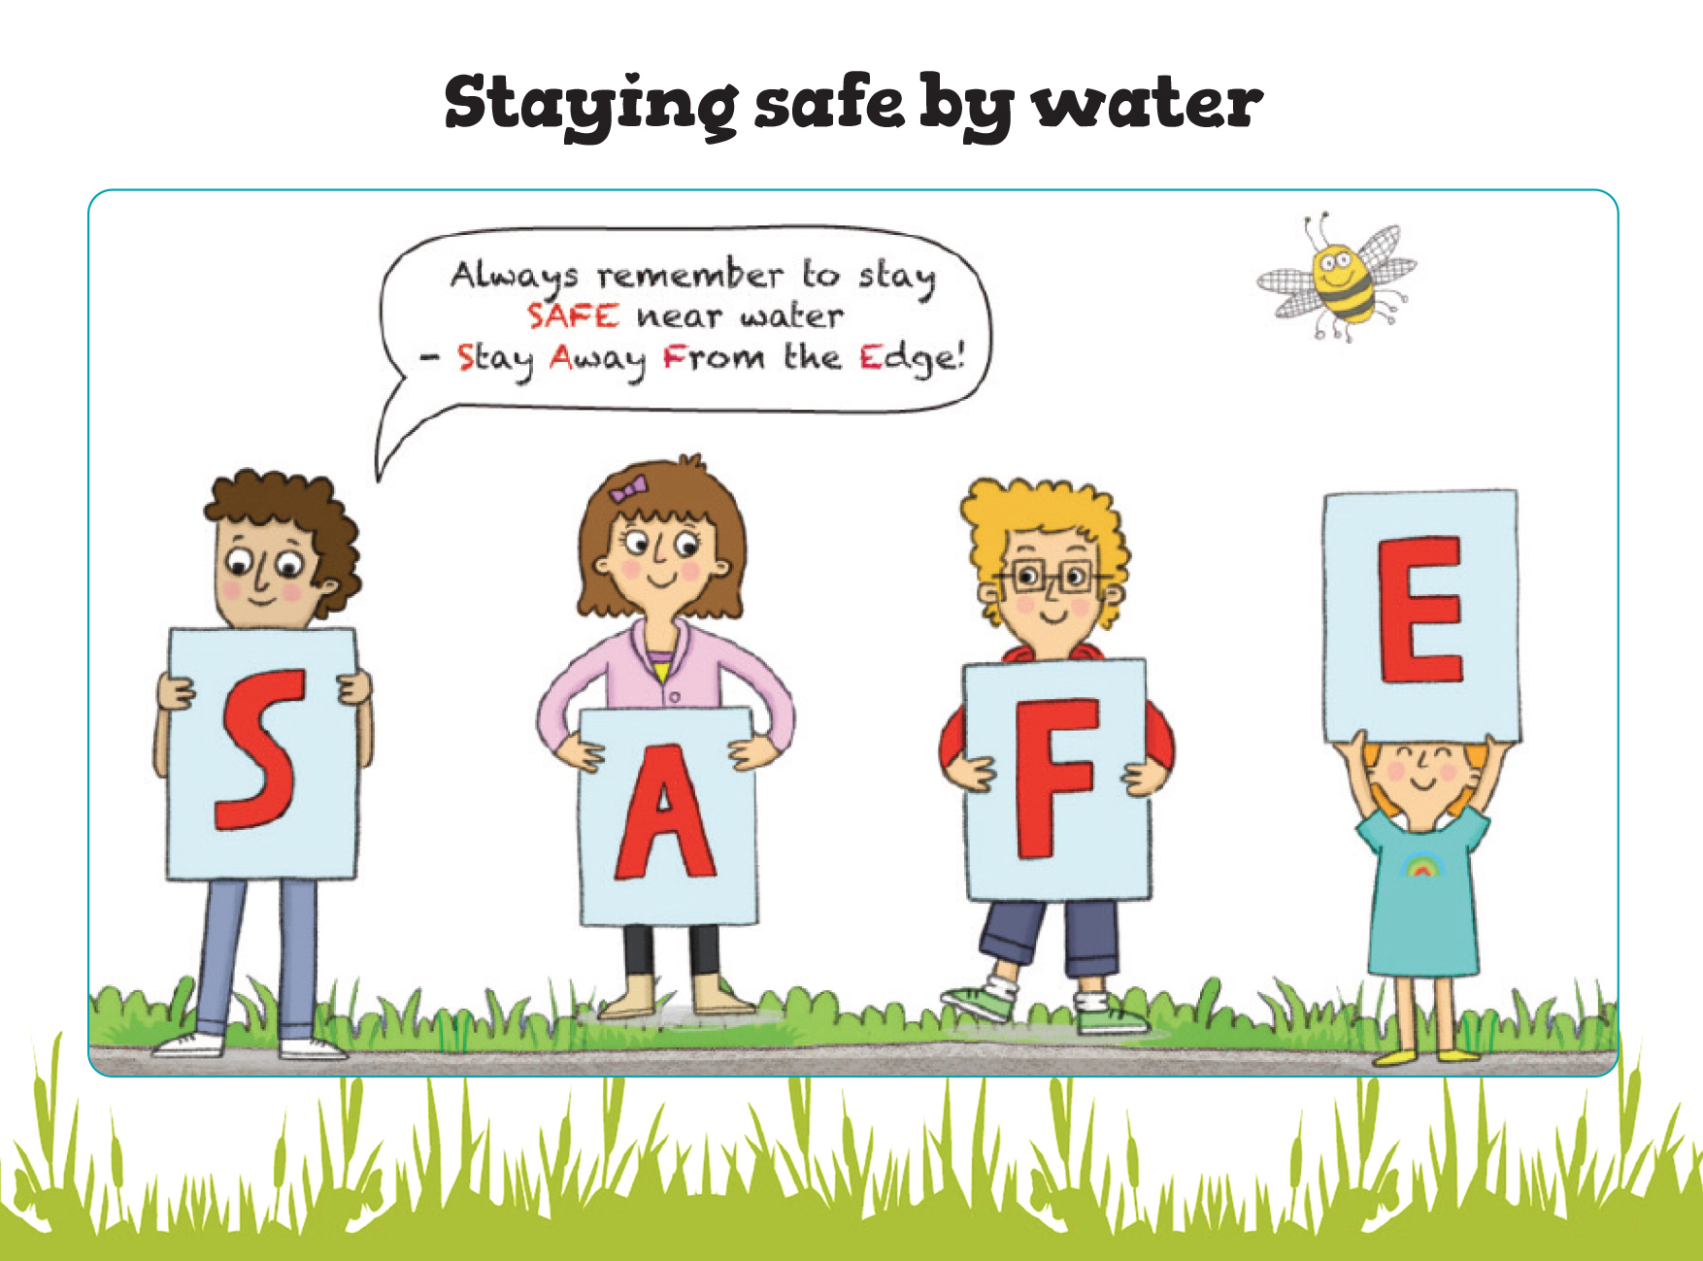
Notes:
Staying safe by water
Ask the children to repeat the SAFE slogan –
S – Stay
A - Away
F - From
E – the Edge!
If there is time, ask 4 children to hold up posters with a letter each and sort themselves into the correct order to spell out SAFE – leave the posters for teacher to pin up on board in classroom as a reminder.

